Slide 1
UNIT – IV NETWORK AND WEB PROGRAMMING
Socket Programming : Handling Multiple Clients
Client side scripting : urllib
Server side scripting : CGI Scripts with User Interaction, Passing Parameters.

Slide 2
Socket Programming
Socket
Sockets are the endpoints of a bidirectional communication channel.
One socket(node) listens on a particular port at an IP, while other socket reaches out to the other to form a connection.
Server forms the listener socket while client reaches out to the server.
Generally it is a combination of IP Address and Port number.

Slide 3
The socket Module
To create a socket, the socket.socket() function available in socket module will be used.
syntax:
s=socket.socket(socket_family,socket_type,protocol=0)
socket_family: AF_INET refers IPv4 family.
AF_UNIX refers UNIX family.
socket_type: This is either SOCK_STREAM (TCP) or SOCK_DGRAM (UDP).
protocol: This is usually left out, default to 0.

Slide 4
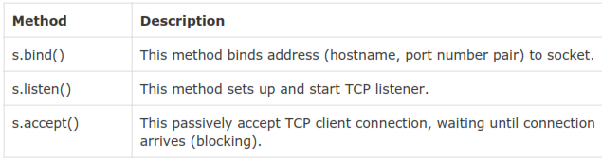
Server Socket Methods

Slide 5

Client Socket Methods

Slide 6
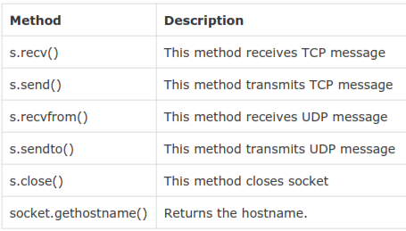
General Socket Methods

Slide 7
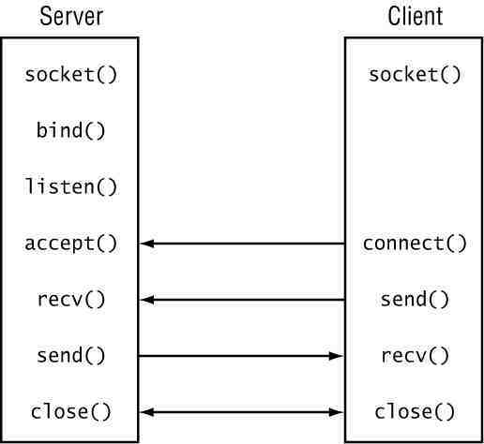
Diagrammatic way of understanding client-server program in python

Slide 8
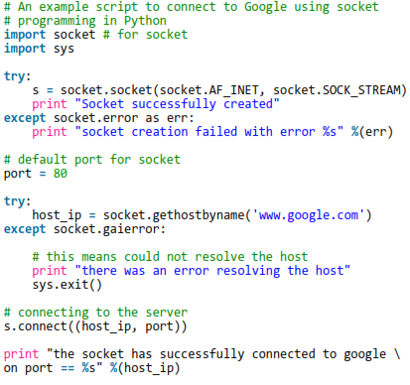
Here is an example of a script for connecting to Google

Slide 9
Output:
Socket successfully created
the socket has successfully connected to google on port == 173.194.40.19

Slide 10
A simple server-client program
Server Program
A server has a bind() method which binds it to a specific ip and port so that it can listen to incoming requests on that ip and port.
A server has a listen() method which puts the server into listen mode. This allows the server to listen to incoming connections.
And last a server has an accept() and close() method. The accept method initiates a connection with the client.
The close() method closes the connection with the client.

Slide 11
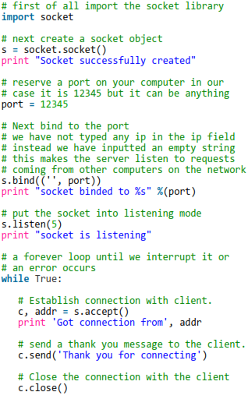
Server Program

Slide 12
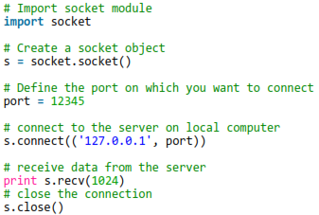
Client Program

Slide 13
Output:
# start the server
$ python server.py #Terminal I
$ telnet localhost 12345 #Terminal II

Slide 14
Server Terminal output
# in the server.py terminal you will see
# this output:
Socket successfully created
socket binded to 12345
socket is listening Got connection from ('127.0.0.1', 52617)

Slide 15
Telnet Terminal
# In the telnet terminal you will get this:
Trying ::1...
Trying 127.0.0.1...
Connected to localhost.
Escape character is '^]'.
Thank you for connecting Connection closed by foreign host.

Slide 16
Server & Client Terminal
# start the server:
$ python server.py
Socket successfully created
socket binded to 12345
socket is listening
Got connection from ('127.0.0.1', 52617)
#start the client:
$ python client.py
Thank you for connecting

Slide 17
Handling Multiple clients (Server program)
# coding: utf-8
from socket import * # Import all from module socket
from _thread import * #Importing all from thread
# Defining server address and port
host = '' #'localhost' or '127.0.0.1' or '' are all same
port = 52000 #Use port > 1024, below it all are reserved
sock = socket() #Creating socket object
sock.bind((host, port)) #Binding socket to a address. bind() takes tuple of host and port.
sock.listen(5) #Listening at the address #5 denotes the number of clients can queue
def clientthread(conn):
#infinite loop so that function do not terminate and thread do not end.
while True:
conn.sendall(b"Hi! I am server") #Sending message to connected client #send only takes string
#Receiving from client
data = conn.recv(1024) # 1024 stands for bytes of data to be received
print (data)
while True:
#Accepting incoming connections
conn, addr = sock.accept()
#Creating new thread. Calling clientthread function for this function and passing conn as argument.
start_new_thread(clientthread,(conn,))
conn.close()
sock.close()

Slide 18
Handling Multiple clients (Client program)
# coding: utf-8
#!usr/bin/python
from socket import *
host = 'localhost' # '127.0.0.1' can also be used
port = 52000
sock = socket()
#Connecting to socket
sock.connect((host, port)) #Connect takes tuple of host and port
#Infinite loop to keep client running.
while True:
data = sock.recv(1024)
print (data)
sock.sendall(b'HI! I am client.')
sock.close()

Slide 19
Client Side scripting
A program can work on the Internet as a client (a program that accesses resources) or as a server (a program that makes services available).
Both kinds of program deal with protocol issues, such as how to access and communicate data, and with data formatting issues.
Data access can be achieved simply with the help of URLs (Uniform Resource Locators)

Slide 20
Python supports URLs with modules
urllib.parse
urllib2
urllib (used in version 3)
Fine-grained control of data access
httplib
ftplib
For mail poplib and smtplib

Slide 21
URL
A URL identifies a resource on the Internet. A URL is a string composed of several optional parts, called components, known as scheme, location, path, query, and fragment.
scheme://lo.ca.ti.on/pa/th?query#fragment
Ex: http://www.python.org:80/faq.cgi?src=fie
mailto:me@yahoo.com

Slide 22
Through urllib, we can access websites, download data, parse data, modify your headers, and do any GET and POST requests you might need to do
urllib.request is a Python module for fetching URLs (Uniform Resource Locators).
It offers a very simple interface, in the form of the urlopen function.

Slide 23
Fetching URLs
Program:
The simplest way to use urllib.request is as follows:
import urllib.request
response = urllib.request.urlopen('http://www.google.com')
html = response.read()
Output:
b'<!doctype html><html itemscope="" itemtype="http://schema.org/WebPage" lang="en-IN"><head><meta content="text/html; charset=UTF-8" http-equiv="Content-Type"><meta content="/images/branding/googleg/1x/googleg_standard_color_128dp.png"itemprop="image"><title>Google</title><script>(function(){window.google={kEI:\'RzjDWbGbB8fc0ATcor6ICA\',kEXPI:\'1352613,1353383,1353746,1354276,1354401,1354443,1354626,1354688,1354750,1354875,1355174,1355204,1355217,1355507,1355535,3700326,3700476,4029815,4031109,4043492,4045841,4048347,4063220,40717………………………………………………………………….

Slide 24
If you wish to retrieve a resource via URL and store it in a temporary location, you can do so via the urlretrieve() function:
Program
import urllib.request
local_filename,headers=urllib.request.Urlretrieve('http://python.org/')
html = open(local_filename)

Slide 25
HTTP is based on requests and responses - the client makes requests and servers send responses.
urllib.request mirrors this with a Request object which represents the HTTP request you are making.
import urllib.request
req=urllib.request.Request('http://www.voidspace. org.uk')
response = urllib.request.urlopen(req)
the_page = response.read()

Slide 26
There are two methods of data transfer with urls, and they are GET and POST. The natural method is a GET request, which means you make a request and you get data. The other is POST, where you send data into the server.

Slide 27
urllib.parse
The urllib.parse module provides functions urlparse for breaking URLs down into their component parts.
Program:
from urlparse import urlparse
parsed=urlparse('http://netloc/path; parameters?query=argument#fragment')
print (parsed)

Slide 28
Output:
ParseResult(scheme='http', netloc='netloc', path='/path', params='parameters', query='query=argument', fragment='fragment')

Slide 29
The urlsplit() function is an alternative to urlparse(). It behaves a little different, because it does not split the parameters from the URL.

Slide 30
urljoin()
In addition to parsing URLs, urlparse includes urljoin() for constructing absolute URLs from relative fragments.
Program:
from urllib.parse import urljoin
print urljoin('http://www.example.com/path/file.html', 'anotherfile.html'))
print (urljoin('http://www.example.com/path/file.html', '../anotherfile.html'))

Slide 31
output:
$ python urlparse_urljoin.py
http://www.example.com/path/anotherfile.html
http://www.example.com/anotherfile.html

Slide 32
Server side Scripting
CGI Script: The Common Gateway Interface, or CGI, is a set of standards that define how information is exchanged between the web server and a custom script
Very basic in web development
Programs that run on server
App protocol used by web servers to transfer data between browsers/clients and servers

Slide 33
Web browsing
To understand the concept of CGI, let us see what happens when we click a hyper link to browse a particular web page or URL.
Your browser contacts the HTTP web server and demands for the URL, i.e., filename.
Web Server parses the URL and looks for the filename. If it finds that file then sends it back to the browser, otherwise sends an error message indicating that you requested a wrong file.
Web browser takes response from web server and displays either the received file or error message.

Slide 34
CGI Script
However, it is possible to set up the HTTP server so that whenever a file in a certain directory is requested that file is not sent back; instead it is executed as a program, and whatever that program outputs is sent back for your browser to display
This function is called the Common Gateway Interface or CGI and the programs are called CGI scripts.

